Slide 1
Chapter 14: k-Means
Hans
13/05/2021

Slide 2
Unsupervised Learning
Cannot perform regression, as we don’t know the outputs for any points.
Classification is possible which is to find clusters of similar inputs.
The algorithm shoule be independent of the task.
We have learnd some algorithms on dimensionality reduction in Chapter 6.
Input space and weight space from chapter 2 may help us for a general error criterion.

Slide 3
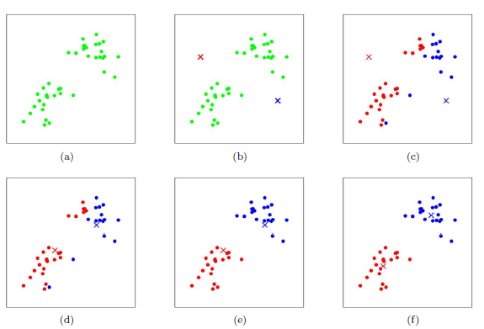
k-Means Algorithm
Choose k random positions in the input space
Compute the distance to each cluster centre and assign the datapoint to the nearest cluster centre
Move the position of the centre to the mean of the points in that cluster.
Repeat Step 2 and 3 until the cluster centres stop moving.

Slide 4
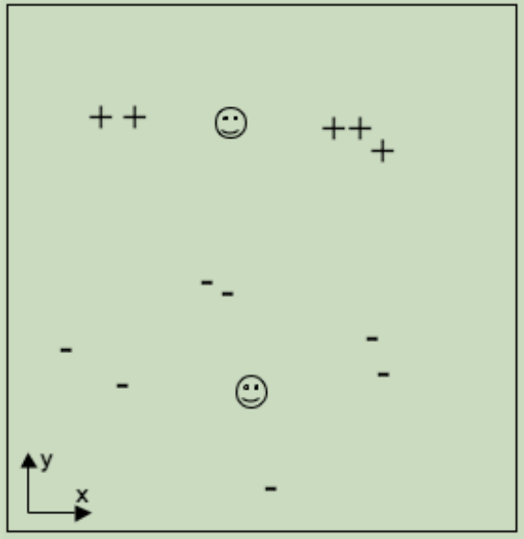
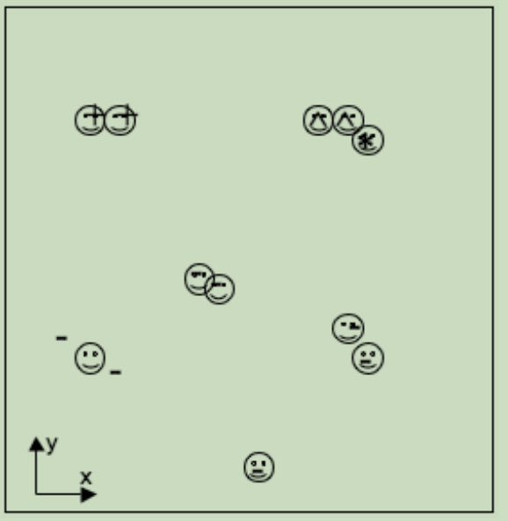
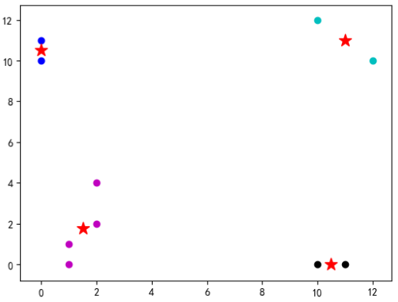
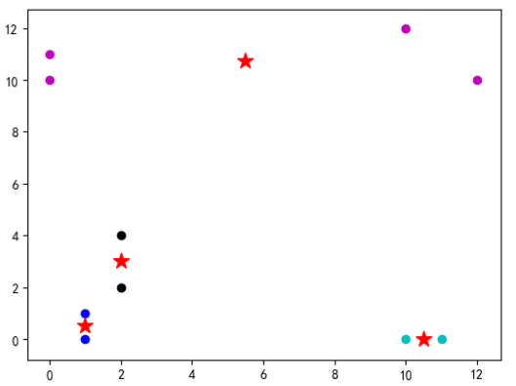
k-Means Algorithm
Different initial positions may lead to different final results.
The number of k is important, never let it be too small or too large.
Range k from a to b, perform k-means several times for each trail, then calculate the mean value of Sum of Square Error or Silhouette Coefficient to judge the best k.

Slide 5
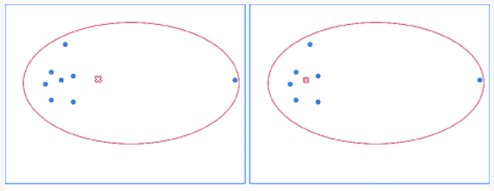
k-Means Algorithm
Dealing with Noise:
On one hand, we can remove noise by deploying k-means.
On the other hand, if we have to face noise, using median instead of mean is a good way.
a. mean
a. median

Slide 6
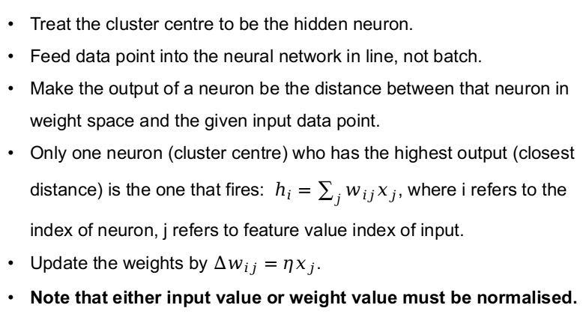
The k-Means Neural Network
Treat the cluster centre to be the hidden neuron.
Feed data point into the neural network in line, not batch.
Make the output of a neuron be the distance between that neuron in weight space and the given input data point.
Only one neuron (cluster centre) who has the highest output (closest distance) is the one that fires: $h_{i}=\sum_{j}{w_{ij}x_{j}}$, where i refers to the index of neuron, j refers to feature value index of input.
Update the weights by $∆w_{ij}=ηx_{j}$.
Note that either input value or weight value must be normalised.

Slide 7








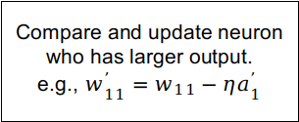





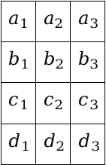
The k-Means Neural Network
$$a_{1}^{’}$$
$$w_{11}$$
$$w_{21}$$
$$w_{1}$$
$$h_{1}$$
Compare and update neuron who has larger output.
e.g., $w_{11}^{’}=w_{11}−ηa_{1}^{’}$
Norm
$$a_{2}^{’}$$
$$w_{12}$$
$$a_{1}$$ | $$a_{2}$$ | $$a_{3}$$
$$b_{1}$$ | $$b_{2}$$ | $$b_{3}$$
$$c_{1}$$ | $$c_{2}$$ | $$c_{3}$$
$$d_{1}$$ | $$d_{2}$$ | $$d_{3}$$
$$w_{22}$$
$$w_{2}$$
$$h_{2}$$
$$w_{13}$$
$$a_{3}^{’}$$
$$w_{23}$$
weights are randomly initialsed, whose sum of square is 1.

Slide 8

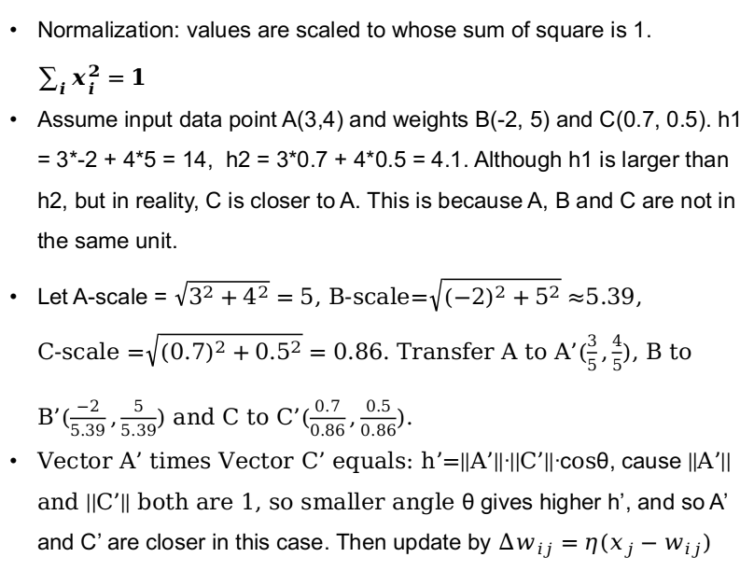
3
-2
B
h1 = 14
0.7
The k-Means Neural Network
5
4
C
h2 = 4.1
0.5
Normalization: values are scaled to whose sum of square is 1. $\sum_{i}{x_{i}^{2}=1}$
Assume input data point A(3,4) and weights B(-2, 5) and C(0.7, 0.5). h1 = 3*-2 + 4*5 = 14, h2 = 3*0.7 + 4*0.5 = 4.1. Although h1 is larger than h2, but in reality, C is closer to A. This is because A, B and C are not in the same unit.
Let A-scale = $\sqrt{3^{2}+4^{2}}=5$, B-scale=$\sqrt{{(−2)}^{2}+5^{2}}≈$5.39, C-scale =$\sqrt{{(0.7)}^{2}+{0.5}^{2}}=0.86$. Transfer A to A’($\frac{3}{5},\frac{4}{5}$), B to B’($\frac{−2}{5.39},\frac{5}{5.39}$) and C to C’($\frac{0.7}{0.86},\frac{0.5}{0.86}$).
Vector A’ times Vector C’ equals: h’=||A’||·||C’||·cosθ, cause ||A’|| and ||C’|| both are 1, so smaller angle θ gives higher h’, and so A’ and C’ are closer in this case. Then update by $∆w_{ij}=η{(x}_{j}−w_{ij})$
B
A
C
B’
A’
C’
($∆w_{ij}=ηx_{j}$)

Slide 9
Thank you

